Slide 1


Amazon items recommendation
Dor Meir, 22.2.2024

Slide 2
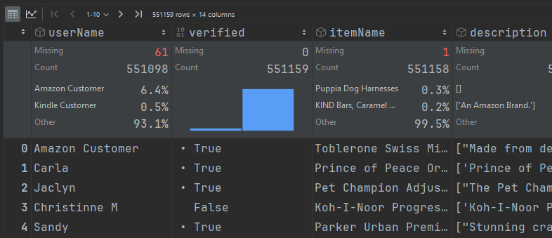
Introduction
Kaggle dataset, collected from Amazon reviews
Content
500000+ reviews
100000+ users
100000+ items
12 features about items, reviews and users
Task build a recommender system: top 5 rating-predicted items
Introduction
Data Insights
Model Selection
Comparison Methodology
Service Deployment

Slide 3
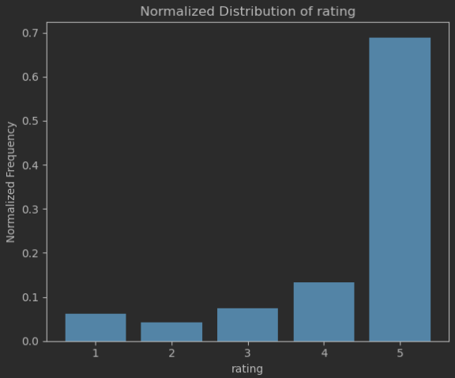
Data Insights
Target (ratings) is left skewed
77% items < 5 reviews, 87% users < 6 reviews
After filtering → 15k users, 25k items
5% user ratings unverified → dropped
Assume each userName is unique
14% ratings by non-unique “Amazon” or “Kindle” Customer
73k ratings are duplicates → dropped
Train (80% data) is 136k rows
Introduction
Data Insights
Model Selection
Comparison Methodology
Service Deployment

Slide 4
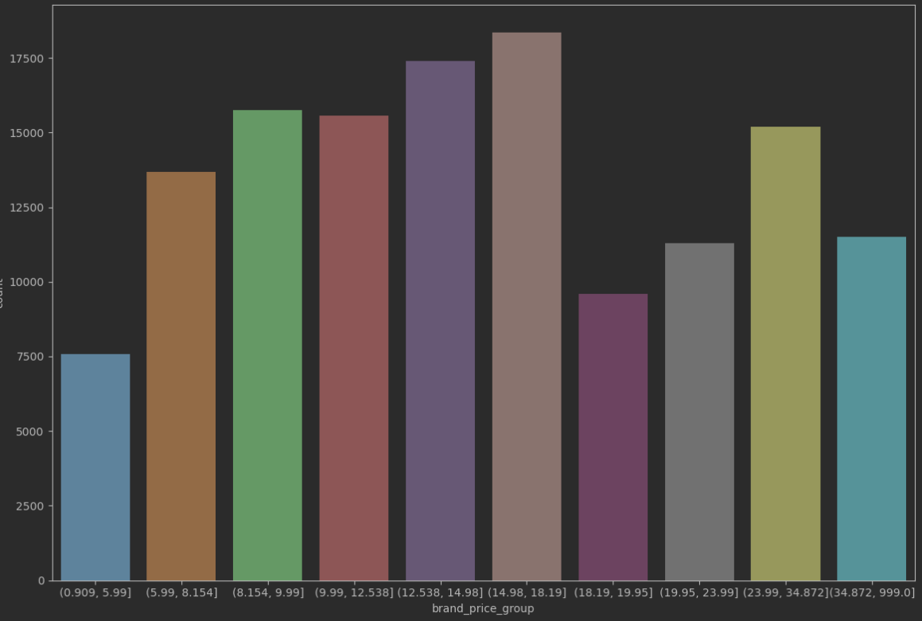
Data Insights - continued
60% items < 2 brands, 7% ratings mention prices
→ Item_id = brand + itemName + price
Top item: KIND’s Caramel snack, 500 reviews (0.4%)
Median review:
2 words summary (“X stars”), 509 chars description, no votes
one word Text (“Good”) 5 images, 5 features, price of 13$
Brands: 8k unique, 2% of reviews: “KONG”, 0.1% missing
Categories: 9 unique (<1% were merged), 44% “Pet Supplies”
Prices: 10 price groups, 14.6% missing, imputed by:
0.5% - Same item_id older reviews (275 dates, no change over time)
12.8% - brand & category means (most are close to mean), 1.3% Categories
Introduction
Data Insights
Model Selection
Comparison Methodology
Service Deployment

Slide 5
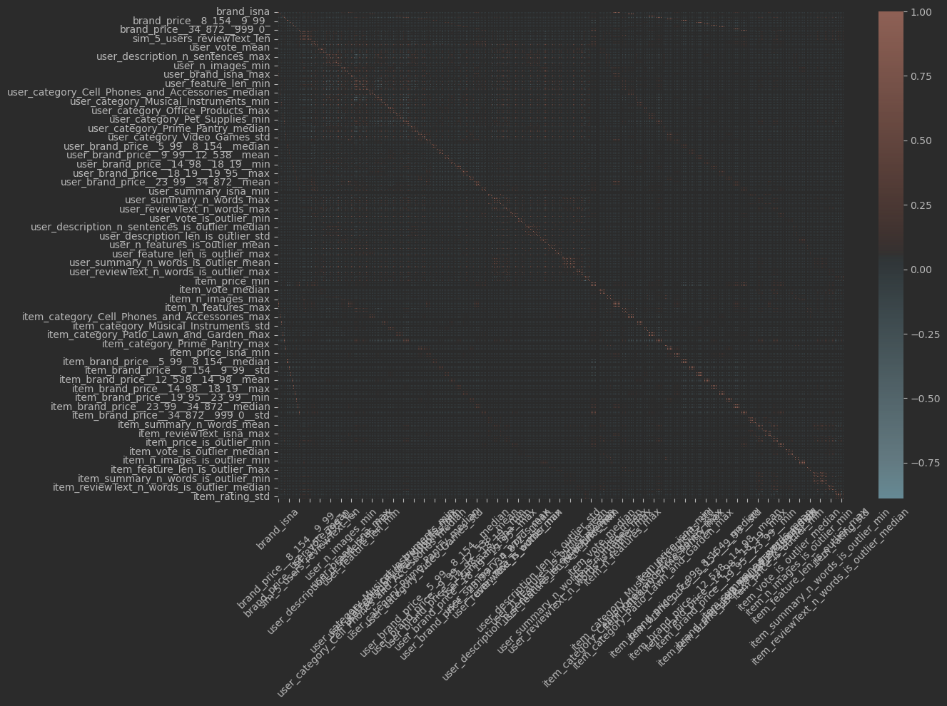
Data Insights - continued
450 features engineered
Dummies for categories
Dummies for rows of missing values and outliers
User specific statistics: min, mean ,median ,max, std
Item specific statistics: min, mean ,median ,max, std
Collaborative filtering: weighted averages of similar users
80 features dropped due to high correlation (90%)
Some features had different distribution for train, validation and test
Highest correlated features to target (but less than 50%)
Item specific rating: mean, median, max, std.
Introduction
Data Insights
Model Selection
Comparison Methodology
Service Deployment

Slide 6
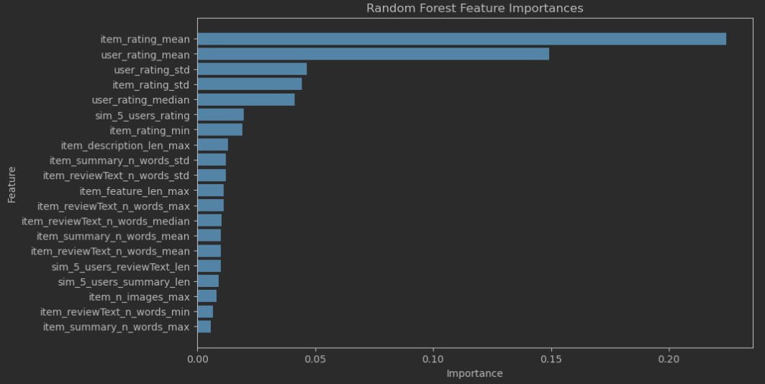
Model Selection
Mean user rating (Baseline Model)
Benchmark. Had surprisingly low error.
Linear Regression
The go-to regression model. Highly Interpretable
Linear Regression L1 regularization (Lasso):
LR needed feature selection. Only one important feature.
Random Forest Regressor (different max_depths):
Lasso didn’t capture complex relationships. Non-linear Bagging + selection
Light Gradient Boosting Machine (LightGBM):
Non-linear Boosting, complex + selection, asymmetrical, very fast
Introduction
Data Insights
Model Selection
Comparison Methodology
Service Deployment

Slide 7
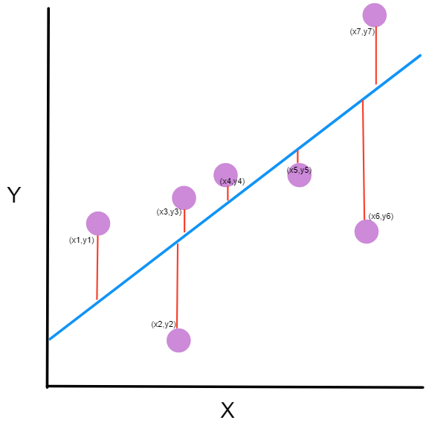
Comparison Methodology
Metrics
Mean Absolute Error (MAE)
Rather easy to interpret, large errors have proportionally large impact.
Mean Squared Error (MSE)
Squaring gives bigger weight to bigger errors. Common LR loss function.
Mean Absolute Percentage Error (MAPE)
Average abs differences in %. Interpretable, but overestimation is downplayed.
R2 (Coefficient of Determination)
In linear models, % of variance explained. Mathematically increases with features.
Mean absolute error on each target value, Max error
Distribution of error over bins (and max error). Each range: underfitting/overfitting.
Introduction
Data Insights
Model Selection
Comparison Methodology
Service Deployment

Slide 8
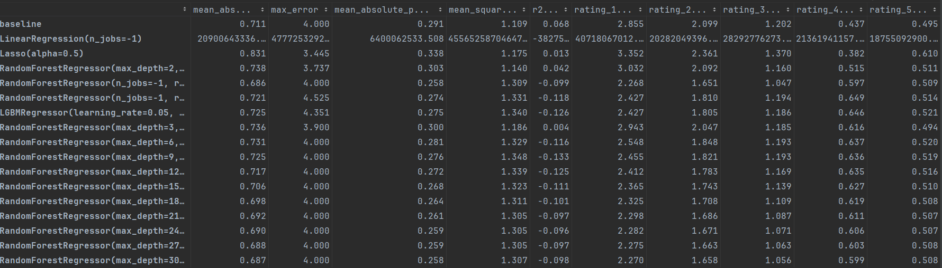
Comparison Methodology
RF max_depth=2
had 3 important features, but MAE & MSE > baseline.
RF max_depth=None
MAE < baseline, MSE > baseline – more extreme errors. Smaller errors on rating <=3. depth – overfit?
LGBM defaults
More equal feature importance, MAE & MSE > baseline.
LGBM grid searched on max_depth, learning_rate, n_estimators.
Similar errors, a little better on rating <=3.
RF grid search on max_depth
Higher Complexity → better MAE & MSE
Didn’t outperform max_depth=None
Not enough time to mitigate overfitting,
With more n_estimators or feature selection
Introduction
Data Insights
Model Selection
Comparison Methodology
Service Deployment

Slide 9
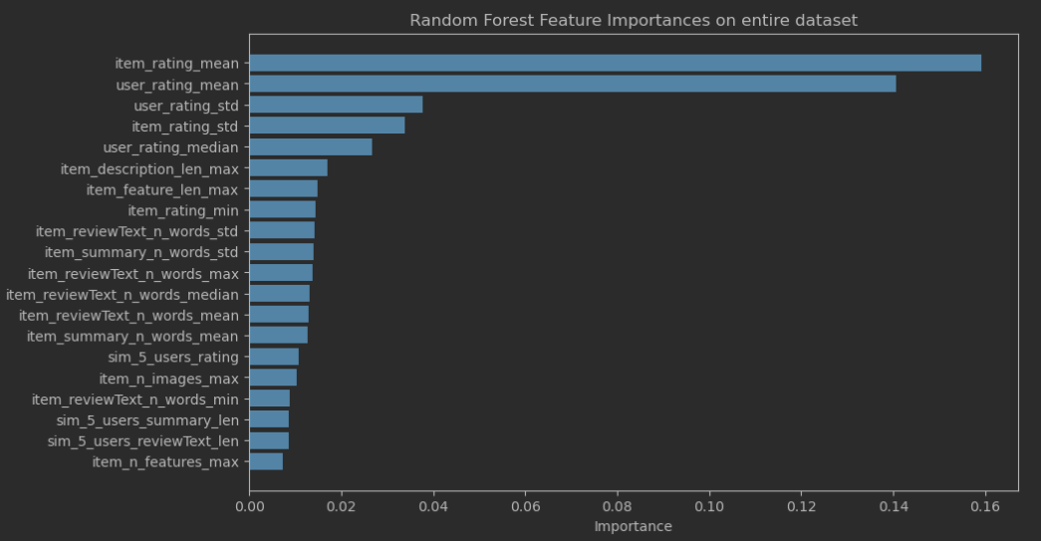
Model Selection -decision
RF max_depth=None
MAE < baseline, MSE > basline (bigger errors), better on smaller bins → filters unlikable items better.
Even if we wanted to, we can’t pick basline as it gives same rating to all possible user’s items.
For lack of time, selected this though it might overfit.
As expected, was a little worse on Test data. Hoping final train on entire data will mitigate a little.
Introduction
Data Insights
Model Selection
Comparison Methodology
Service Deployment
Top important
features are similar
on entire data model

Slide 10
Service Deployment
Dropped items with < 0.1% ratings.
Similarity features took too long to compute with not enough benefit → dropped
Predict ratings for all pairs of users and items the users haven't purchased.
Filtered top 5 recommendations per user, exported to csv.
Filtered all users top 5 recommendations in different categories, exported to csv.
User exists?
User with history?
5 recommended items
No – 5 Most popular items per category
No
5 Most popular items per category
Introduction
Data Insights
Model Selection
Comparison Methodology
Service Deployment

Slide 11
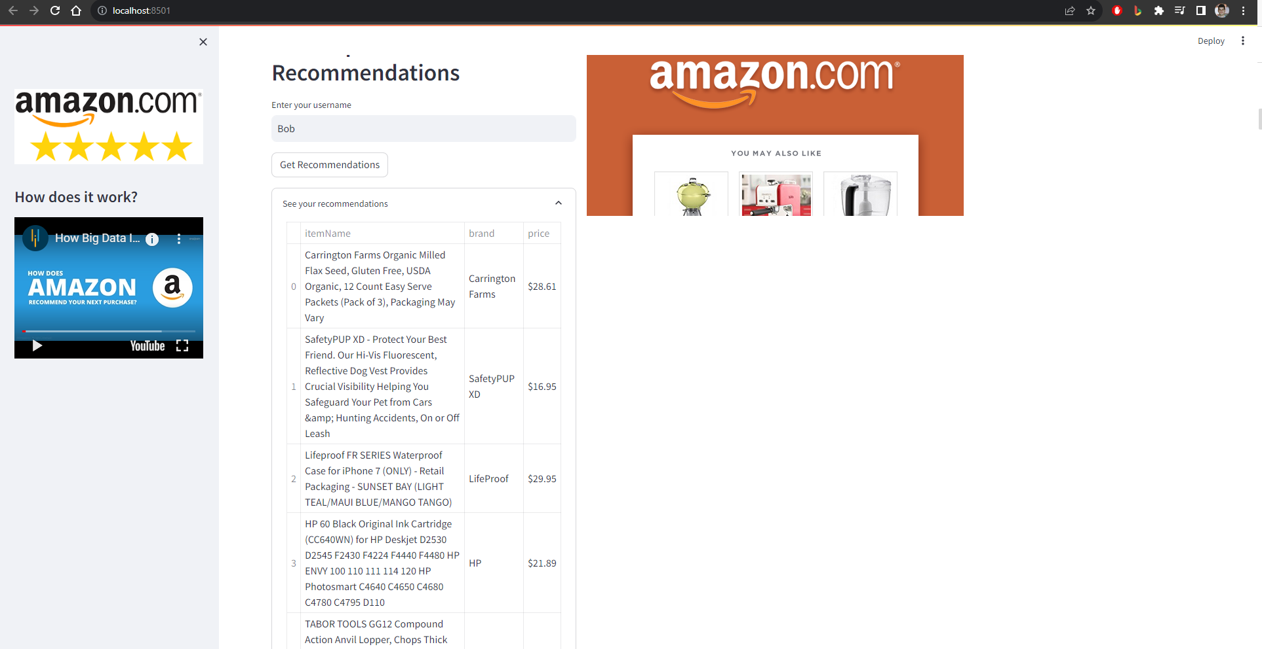
Service Deployment
Introduction
Data Insights
Model Selection
Comparison Methodology
Service Deployment

Slide 12
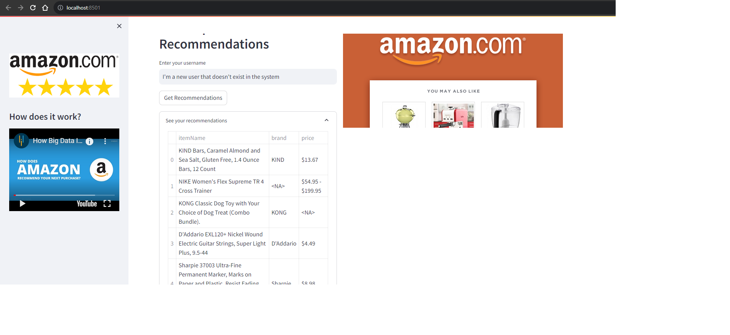
Service Deployment
Introduction
Data Insights
Model Selection
Comparison Methodology
Service Deployment

Slide 13
Service Deployment
Run app
Introduction
Data Insights
Model Selection
Comparison Methodology
Service Deployment

Slide 14
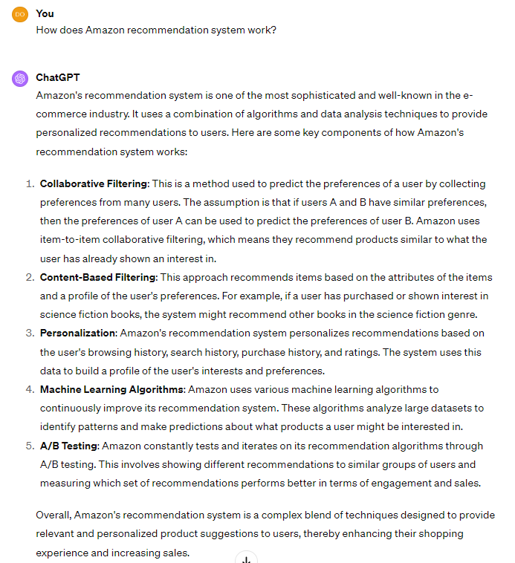
Questions?

